Slide 1



Product Inventory Analysis
View in Power BI
Last data refresh:
09/05/2025 21:17:07 UTC
Downloaded at:
09/05/2025 21:19:08 UTC

Slide 2
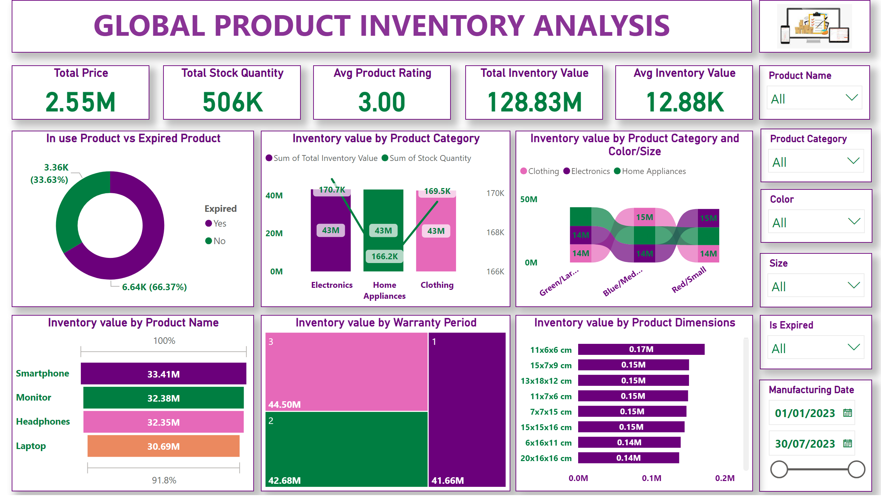
Page 1
Notes:
textbox
No alt text provided
image
No alt text provided
slicer
No alt text provided
slicer
No alt text provided
slicer
No alt text provided
Total Price
No alt text provided
Total Stock Quantity
No alt text provided
Avg Product Rating
No alt text provided
Total Inventory Value
No alt text provided
Avg Inventory Value
No alt text provided
slicer
No alt text provided
slicer
No alt text provided
slicer
No alt text provided
In use Product vs Expired Product
No alt text provided
Inventory value by Product Category
No alt text provided
Inventory value by Product Category and Color/Size
No alt text provided
Inventory value by Product Name
No alt text provided
Inventory value by Warranty Period
No alt text provided
Inventory value by Product Dimensions
No alt text provided

